Slide 1
GESTATIONAL DIABETES PREDICTION IN PREGNANT WOMAN
A Study of Diabetes

Slide 2
Contents
Introduction
Background
Dataset
Data description
Related Work
Modeling
Model Evaluation
Future work
Conclusion
References

Slide 3
Introduction
Diabetes: deals with blood sugar how it is using it
Diabetes types
Type 1 (body not produce enough insulin)
Type 2 (body not use the insulin)
Gestational diabetes (in pregnant woman)
Problem statement
No cure found yet
examine the gestational diabetes in pregnant woman
Motivation

Slide 4
Background
First case of diabetes report about 3000 years ago mentioned in Egyptian manuscript.
In 1936 differentiate between type 1 and type 2 diabetes
Different lab practices used to examine the gestational diabetes in pregnant woman.
Gestational diabetes recognized in 24 28 weeks of pregnancy
Different machine learning model used to predict the gestational diabetes early

Slide 5
Dataset
Data source
This dataset originates from Kaggle for the non-commercial and public uses purpose only
Pima Indian heritage
All the patients are female and at least 21 year old
Because we are examined the gestational diabetes
This data comes from national institute of diabetes and digestive and kidney diseases

Slide 6
Dataset Description
This dataset comes from Kaggle and national institute of diabetes and digestive and kidney diseases
This data contains the 9 nine attributes to examine or predict the gestational diabetes
Attributes
BMI
Blood pressure
Number of pregnancies
Glucose
Skin thickness
Insulin
Age
Diabetes pedigree function
Outcome
Check the imbalance data according to class variable (Exploratory data analysis)
Check statistics of the data (correlation and covariance)

Slide 7
Related Work
An Dinh used the different supervise machine learning models to detect the diabetes and cardiovascular diseases. He got the on average 84% accuracy.
This study implements the different machine learning models on the authentic reports of patients given by the diabetologists. Different model has the different accuracy of the patients.
Yunzhen Ye used different machine learning and deep learning model to predict the early diabetes in the pregnant woman at 24 28 weeks of pregnancy. He got the on average 95% accuracy.
In this study, finds the gestational diabetes in patients and 15% percent woman of the world has this issue in pregnancy.

Slide 8
Modeling
Dataset split
In this data-driven application, down sampling is used to split the dataset into 80% / 20% training and testing dataset.
Random forest
Fine tune model
Feature scaling
It convert features between 0 to 1
K-fold cross validation
In this divide the dataset into k folds and hold one-fold from them and trained the model remaining k-1 folds.
It improves the accuracy on testing dataset from 87.58 % to 89.54 %
In this case, used the 10-fold cross validation
Family method is CV

Slide 9
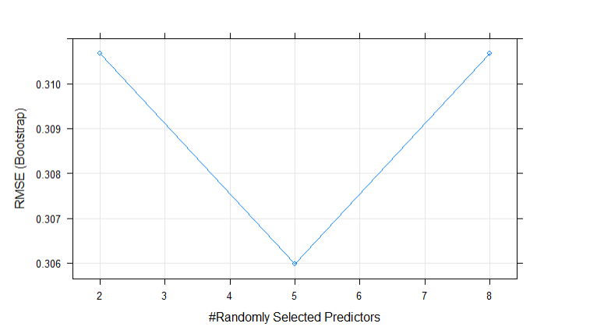
Random forest with default parameters

Slide 10
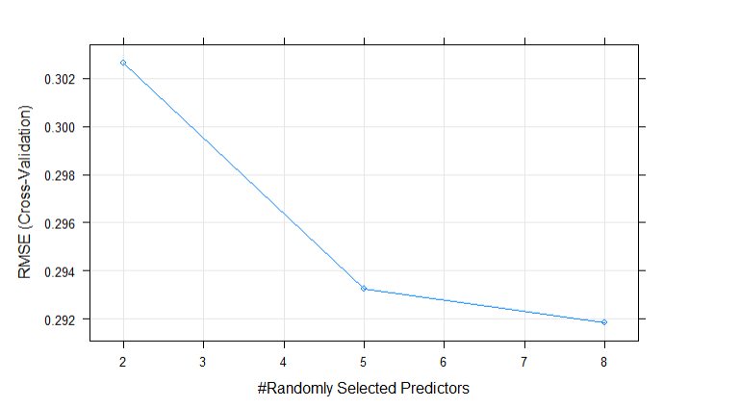
Random forest with K-fold cross validation

Slide 11

Model Evaluation
Confusion Matrix
Accuracy
Training accuracy
99%
Testing accuracy
89.54%
Correlation between actual and predicted values
68%
Root mean square error (how good fit the line to the data point)
0.27

Slide 12
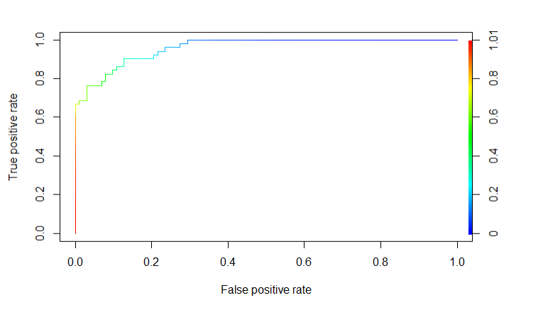
Model Evaluation ROC Curve
ROC Curve
It is performance measurement of the machine learning model.
Roc curve gives us trade-off between the true positive rate and false positive rate.

Slide 13
Future Work
Add more authentic data to get good accuracy
It can be web portal to generate questionnaire to predict the gestational diabetes.
Also it can be a mobile application to generate questionnaire for predicting diabetes because almost everyone has the smart mobile in his hand.

Slide 14
Conclusion
In this study, built a machine learning model to predict the gestational diabetes in pregnant woman.
This study showed the good results by training machine learning model and while testing it
It showed the 99% training accuracy and 89.54% testing accuracy on new data.

Slide 15
References
Abdulfatai B. Olokoba, O. A. (2012 Jul). Type 2 Diabetes Mellitus: A Review of Current Trends. Oman medical journal vol. 27,4 (2012): 269-73. doi:10.5001/omj.2012.68, 8.
An Dinh, S. M. (2019). A data-driven approach to predicting diabetes and cardiovascular disease with machine learning. BMC medical informatics and decision making, 19(1) (p. 13). USA: BMC .
Melillo, G. (2020). Machine Learning Predicts Incidence of Gestational Diabetes. AJMC, 10.
Norouzi, M. (2021 Jun). Type-2 Diabetes as a Risk Factor for Severe COVID-19 Infection. Microorganisms;9(6):1211. doi: 10.3390/microorganisms9061211. PMID: 34205044; PMCID: PMC8229474., 12.
Swapnil Karkhanis, M. W. (2020). Detection and Risk Analysis of Diabetes Using Machine Learning. International Research Journal of Engineering and Technology (IRJET) (p. 5). Maharashtra, India: IRJET.
Ulla Kampmann, L. R. (2015 Jul 25). Gestational diabetes: A clinical update. World J Diabetes;6(8):1065-72. doi: 10.4239/wjd.v6.i8.1065. PMID: 26240703; PMCID: PMC4515446., 7.
Vishwendra Singh, K. G. (2021). Eect of an Oral Health Preventive Protocol on Salivary Parameters and Gingival Health of Children with Type 1 Diabetes. Int J Clin Pediatr Dent, 6.
Yunzhen Ye, Y. X. (2020). Comparison of Machine Learning Methods and Conventional Logistic Regressions for Predicting Gestational Diabetes Using Routine Clinical Data: A Retrospective Cohort Study. Hindawi (p. 10). Shanghai, china: Journal of Diabetes Research.

